Slide 1



MAVEN COFFEE SALES ANALYSIS
USING SQL

Slide 2

TABLE
CREATE TABLE transactions (
transaction_id INT,
transaction_date DATE,
transaction_time TIME,
transaction_qty INT,
store_id INT,
store_location VARCHAR(100),
product_id INT,
unit_price DECIMAL(10, 2),
product_category VARCHAR(50),
product_type VARCHAR(100),
product_detail VARCHAR(100)
)

Slide 3
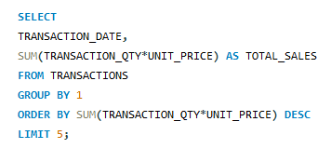

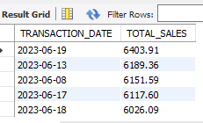

-- Find the top 5 dates with the highest total sales:

Slide 4

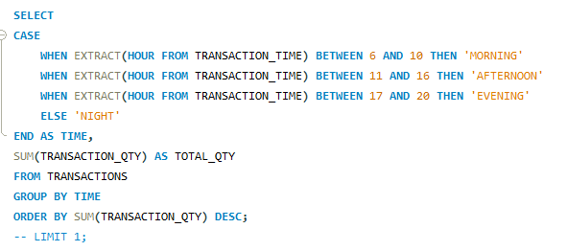





-- Determine peak transaction Time (by quantity):

Slide 5
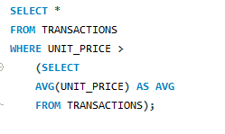

-- Get all transactions where unit_price is higher than the average price of its category:

Slide 6
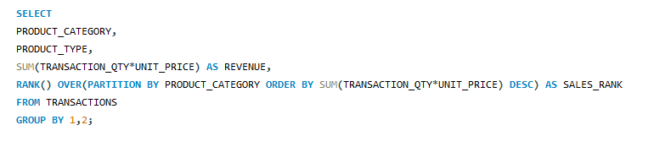
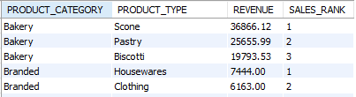
-- Rank product types by sales within each category:

Slide 7
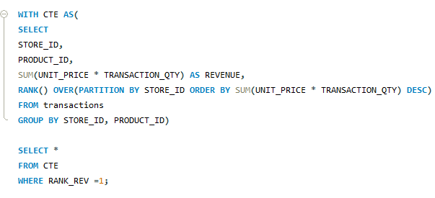

-- Find the top-selling product per store by revenue:

Slide 8
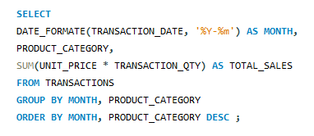
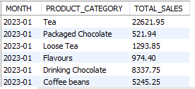
-- Monthly sales trend by product category:

Slide 9
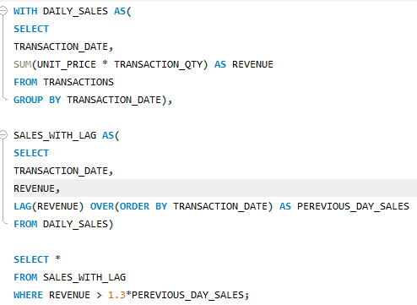

-- List dates where sales increased more than 30% compared to the previous day:

Slide 10
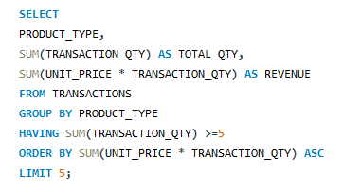
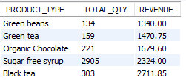
-- Find the slowest-selling product types (sold at least 5 times but with lowest revenue:

Slide 11


Thank's For Watching

Slide 12













































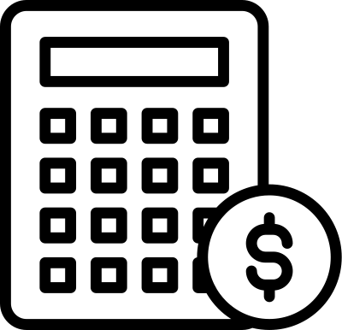


RESOURCE PAGE

